Slide 1
H13-711
FusionInsight HD
V100R002C70
V2.0
Jia Yuntao/WX494273
2018-05
Gao Dongdong/ WX321719
New

Slide 2
Technical Principles of HDFS

Slide 3
Upon completion of this course, you will be able to know:
HDFS application scenarios
HDFS system architecture
Key HDFS features

Slide 4
HDFS Overview and Application Scenarios
Position of HDFS in FusionInsight HD
HDFS System Architecture
Key Features

Slide 5

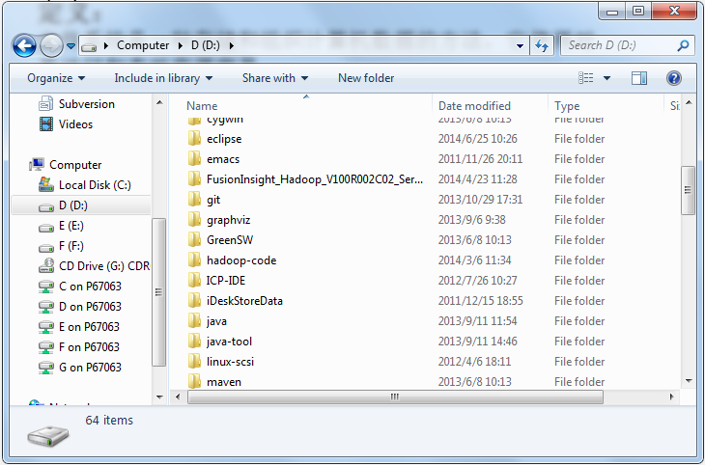
Dictionary vs. File System
Dictionary | File System
Character index | File name Metadata
Dictionary body | Data block
Notes:
File system: is a way of storing and organizing computer data to facilitate data access and query.
File name: is used for locat of a file in the file system.
Metadata: records file attributes such as file name, length, user group, and location.
Block: is the smallest file storage unit. Storage media is divided into zones, and data is stored in the zones.

Slide 6
HDFS Overview
Hadoop distributed file system (HDFS) is developed based on Google file system (GFS) and runs on commondity hardware.
In addition to the features provided by other distributed file systems, HDFS also provides the following features:
High fault tolerance: resolves hardware unreliability problems.
High throughput: supports applications involved with a large amount of data.
Large file storage: supports TB and PB level data storage.
HDFS is applicable to:
Store large files
Streaming data access
HDFS is inapplicable to:
Store massive small files
Random write
Low-delay read
Notes:
HDFS is inapplicable to:
[1] Applications with low-delay (dozens of milliseconds) access requirements
Reason: HDFS is designed for high throughput applications, which bring high delay.
[2] Storage of massive small files
Reason: When NameNode is started, file system metadata is loaded to memory. The number of files that can be stored in the system is restricted by NameNode memory capacity. The directory and data block of a file each is about 150 bytes in size. If there are 1 million files with each occupying a data block, at least 300 MB memory is required. If there are 1 billion files, the required memory will be larger.
[3] Multi-tenant write and random file modification
Reason: HDFS has only a writer and data is written to the end of a file.
Streaming data access: after the data set is generated, various analyses are performed on this data set for a long time. Each analysis will involve most or even all of the data in the data set. So the time delay of reading the entire data set is much more important than that of reading the first record. Flow data access corresponds to random data access, which requires less latency of locating, querying or modifying data delay and is more suitable for multiple reading and writing after creating data. Traditional relational database is very appropriate for this.

Slide 7
HDFS Application Scenarios
HDFS is a distributed file system of the Hadoop technical framework and is used to manage files on multiple independent physical servers.
It is applicable to the following scenarios:
Website user behavior data storage
Ecosystem data storage
Meteorological data storage

Slide 8
HDFS Overview and Application Scenarios
Position of HDFS in FusionInsight HD
HDFS System Architecture
Key Features

Slide 9
Position of HDFS in FusionInsight
Application service layer
OpenAPI/SDK
REST/SNMP/Syslog
DataFarm
Data
Porter
Information
Miner
Knowledge
Farmer
Wisdom
Manager
Hadoop API
Plugin API
System management
LibrA
Service governance
HIVE
M/R
Spark
Storm
Flink
Hadoop
YARN/ Zookeeper
Security management
HDFS/HBase
As a Hadoop storage infrastructure, HDFS serves as a distributed, fault-tolerant file system with linear scalability.

Slide 10
HDFS Overview and Application Scenarios
Position of HDFS in FusionInsight HD
HDFS System Architecture
Key Features

Slide 11
Basic System Architecture
Notes:
The HDFS architecture consists of three parts: NameNode, DataNode, and Client.
NameNode is used to store and generate metadata of the file system. An HDFS runs only one NameNode instance.
DataNode is used to store actual data and report the data blocks it manages to NameNode. An HDFS runs multiple DataNode instances.
The Client allows services to access HDFS, and returns data obtained from NameNode and DataNode to services. An HDFS runs multiple client instances, which run together with services.

Slide 12
HDFS Data Write Process
Notes:
The process of writing data to HDFS is as follows:
A service application invokes an API provided by the HDFS client to request for data writing.
The HDFS Client connects to the NameNode, and the NameNode create a file node in the metadata.
The service application invokes the write API to write data into the file.
After receiving the service data, the HDFS Client obtains the data block number and location from NameNode, connects to DataNodes, and establishes a pipeline of DataNodes where data needs to be written to. Then, the HDFS Client uses the proprietary protocol to write data to DataNode 1, and copy the data from DataNode 1 to DataNode 2 and DataNode 2 to DataNode 3.
After data writing is complete, the DataNodes send a confirmation message back to the HDFS Client.
After all data writing is confirmed, the service invokes the HDFS Client to close the file.
After the service runs the close and flush commands in sequence, the HDFS Client connects to the NameNode to confirm that the data writing is complete and makes the metadata be persistent.

Slide 13
HDFS Data Write Process
Notes:
DistributedFileSystem object: The HDFS client creates the file by calling the Create() method of DistributedFileSystem.
FSDataOutputStream object: DistributedFileSystem sends an RPC request to the NameNode to create a new file in the namespace. DistributedFileSystem returns FSDataOutputStream to the client for writing data into FSDataOutputStream. FSDataOutputStream packs DFSOutputStream for I/O communication between the NameNode and DataNodes.
Flush: updates the status after confirmation messages of data writing are sent.

Slide 14
HDFS Data Read Process
Notes:
The process of reading data to HDFS is as follows:
A service application invokes an API provided by the HDFS Client to open a file.
The HDFS Client connects to the NameNode to obtain the file information (data block and DataNode location information).
The service application invokes the read API to read the file.
The HDFS Client connects to the DataNode according to the information obtained from the NameNode to locate the nearest corresponding data blocks.
The HDFS Client connects to multiple DataNodes to read corresponding data blocks.
After data reading is complete, the service application invokes the close API to close the connection.

Slide 15
HDFS Data Read Process
Notes:
DistributedFileSystem object: The HDFS client opens a file by calling the open() method of DistributedFileSystem object.
FSDataInputStream object: DistributedFileSystem sends an RPC request to the NameNode to locate the blocks of the file to be read. DistributedFileSystem returns FSDataInputStream to the HDFS Client for the client to read data from FSDataInputStream. FSDataInputStream packs DFSInputStream for I/O communication between the DataNode and NameNode.

Slide 16
HDFS Overview and Application Scenarios
Position of HDFS in FusionInsight HD
HDFS System Architecture
Key Features

Slide 17
Key Design of HDFS Architecture
Federation storage
NameNode/DataNode
in master/slave mode
Data storage policy
Unified file system namespace
HA
HDFS
Data replication
Multiple access modes
Metadata persistence
Space reclamation
Robustness

Slide 18
HDFS High Availability (HA)
Notes:
The HDFS high availability (HA) is mainly reflected in active/standby NameNode elected by zookeeper to solve NameNode failure problems.
ZooKeeper is mainly used to store status files and active/standby status information. You are advised to deploy three ZooKeepers or more in odd number.
NameNode in active/standby mode: the active NameNode provides services, and the standby NameNode backs up metadata as a hot spare.
ZKFC (ZooKeeper Failover Controller) is used for monitoring the active/standby status of NameNodes.
JN (JournalNode) is used for storing Editlog generated by Active NameNode. Standby NameNode loads Editlog on JN to synchronize metadata.

Slide 19
Notes:
ZKFC controls the NameNode active/standby arbitration.
As a simplified arbitration agent, ZKFC uses the ZooKeeper distributed lock function to implement the active/standby arbitration, and uses the command channel to control the active/standby status of NameNodes. ZKFC is deployed together with NameNodes, with the same quantity.
Metadata Synchronization
The active NameNode provides services externally. Editlog generated is written to local and JN at the same time, and metadata of active NameNode is updated.
After standby NameNode notify the modification of Editlogs, it loads Editlogs into its memory and generates the same metadata as active NameNode. Metadata Synchronization is completed.
Active/Standby FSImages are still stored in their own disks, without interacting. FSImage is a copy of the in-memory metadata periodically written to a local disk, also called a metadata mirroring.

Slide 20
Metadata Persistence
Notes:
EditLog: records user operations and is used for generating new file system images based on the FSImage flie.
FSImage: stores file images periodically.
FSImage.ckpt: Merges fsimage and edits files in the memory to generate a fsimage file, which is written into a disk. This process is called checkpoint. The standby NameNode loads the fsimage and edits files and writes the merged result into a local disk and NFS. In this case, the original fsimage file and the new checkpoint file fsimage.ckpt are stored on the disk. The name of fsimage.ckpt file is changed to fsimage to overwrite the original fsimage file.
EditLog.new: NameNode triggers the merging operation every hour or when the capacity of Editlog is 64 MB. During merging, the data is uploaded to the standby NameNode. Therefore, data read and write cannot be performed at the same time. In this case, NameNode generates a new log file Editlog.new to store the operation logs. After the new fsimage file is obtained, the standby NameNode returns the new fsimage file to overwrite the original fsimage file and rename the Editlog.new file as Editlog.

Slide 21
Metadata Persistence
Notes:
The process of metadata persistence is as follows:
The standby NameNode informs the active NameNode of generating a new log file – Editlog.new. The active NameNode records logs to the EditLog.new file and the standby NameNode obtains the old Editlog.
The standby NameNode downloads the FSImage from the active NameNode and old Editlog from JN.
The standby NameNode merges the old Editlog with old metadata and generates a new metadata file FSImage.ckpt.
The standby NameNode uploads the metadata to the active NameNode.
The active NameNode rolls back the metadata with the newest FSImage.ckpt.
Repeat step 1 to step 5.

Slide 22
HDFS Federation
APP
Client-1
Client-k
Client-n
HDFS
Namespace-1
Namespace-k
Namespace-n
Namespace
NN1
NN-k
NN-n
…
NS-k
…
NS1
NS-n
Pool 1
Pool
Pool n
Block Storage
Block Pools
Common Storage
DataNode1
DataNode2
DataNodeN
…
…
…
Notes:
Cause: single Active NameNode architecture cause potential problems of HDFS cluster scalability and performance. When the cluster is large enough, the memory for NameNode process could reach hundreds of G, resulting in performance bottleneck.
Application scenarios: massive data storage, such as user behavior data of Internet companies, telecom history data, voice data,etc. At this point, the memory of the NameNode is insufficient for such a large cluster.
Federation: each NameNode is responsible for its own directory. Similar to a Linux mount disk to a directory, each NameNode is responsible for only part of the entire HDFS cluster. If NameNode1 is responsible for the /database directory, the file metadata in the /database directory is handled by NameNode1. The NameNodes do not share metadata, and each NameNode has its corresponding standby NameNode.

Slide 23
Notes:
Block pool: a set of file blocks belong to a namespace (NS).
In a federated environment, each namenode maintains a namespace volume, including the metadata of the namespace and the block pool of all file data blocks under that space.
namenode is independent of each other and does not communicate with each other, and one failure does not affect others.
datanode is registered to all namenodes in the cluster, storing data for all the block pools in the cluster.
NameSpace (NS) : The HDFS namespace consists of directories, files, and blocks, which can be understood as logical directory belongs to NameNode.

Slide 24
Data Replication
Notes:
Replica distance formula:
Distance (Rack1/D1, Rack1/D1) = 0: The distance is zero on the same server.
Distance (Rack1/D1, Rack1/D3) = 2: The distance is two on different servers in the same rack.
Distance (Rack1/D1, Rack2/D1) = 4: The distance is four on servers in different racks.
Replica placement policy:
The first replica is placed on a local device.
The second replica is placed on a remote rack.
The third replica is placed on another rack if the first two duplicates are placed on the same rack. Otherwise, the third replica and the first replica are placed on different nodes in the same rack. Other replicas are randomly placed.
If the write requestor is in one of the DataNodes, the data is directly stored in local, otherwise stored in a random DataNode in the cluster.
RACK 1: rack 1
D1: DataNode 1
B1: block 1 on a node

Slide 25
Configuring HDFS Data Storage Policies
By default, the HDFS NameNode automatically selects DataNodes to store data replicas. There are the following scenarios in practice:
Select a proper storage device for layered data storage from multiple devices on a DataNode.
Select a proper DataNode according to directory tags that indicate data importance levels.
Store key data in highly reliable node groups because the DataNode cluster uses heterogeneous servers.

Slide 26
Configuring HDFS Data Storage Policies - Layered Storage
Configuring DataNode with layered storage :
The HDFS layered storage architecture provides four types of storage devices: RAM_DISK (memory virtualization hard disk), DISK (mechanical hard disk), ARCHIVE (high-density and low-cost storage media), and SSD (solid state disk).
Storage policies for different scenarios are formulated by combining the four types of storage devices.
Policy ID | Name | Block Location (Number of Replicas) | Alternative Storage Policy | Alternative Replica Storage Policy
15 | LAZY_PERSIST | RAM_DISK: 1, DISK: n-1 | DISK | DISK
12 | All_SSD | SSD: n | DISK | DISK
10 | ONE_SSD | SSD: 1, DISK: n-1 | SSD, DISK | SSD, DISK
7 | HOT (default) | DISK: n | <none> | ARCHIVE
5 | WARM | DISK: 1, ARCHIVE: n-1 | ARCHIVE, DISK | ARCHIVE, DISK
2 | COLD | ARCHIVE: n | <none> | <none>
Notes:
The 15-LAZY_PERSIST policy is used as an example. It is assumed that a file that is configured with the policy has three block replicas, the first replica is written to RAM_DISK, and the other two written to DISK. As an alternative, the first replica is written to the storage type specified by Alternative Storage Policy in case of RAM_DISK write failure, and the other two replicas are written to the storage type specified by Alternative Replica Storage Policy in case of DISK write failure.

Slide 27
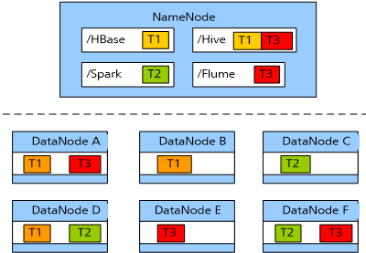
Configuring HDFS Data Storage Policies - Tag Storage
Notes:
Configuring DataNode with tag storage:
Users can flexibly configure HDFS data block policies based on service requirements and data features. One tag expression is set for each HDFS directory, and each DataNode can have one or more tags, which specify the Datanode range for file data storage.
When using a tag-based data block policy to specify a DataNode for the files storage, specify the DataNode range based on tag expressions and then select the appropriate node to store the files within the range.
Supports users to store each block replica to a specified node with different labels. For example, two replicas of data blocks are placed in label L1 datanode, the other replicas of the data blocks are placed on the label L2 datanode.
Supports the policy when failed in selecting nodes, such as selecting one from all nodes at random.
In short, the data to be stored also has labels. The data is stored in the DataNode with the same label.
In the figure above, The /Hbase data is stored in DataNode A, B, and D.

Slide 28
Configuring HDFS Data Storage Policies - Node Group Storage
Notes:
Configuring DataNode with node group storage:
In practice, key data needs to be stored in highly reliable nodes based on service requirements. The system can forcibly save data to specified node groups by modifying DataNode storage policies.
Constraints:
The first replica is chosen from a mandatory rack group (group 2). If there are no available nodes in the mandatory rack group, data write fails.
The second replica is chosen from a local client or from a random node in a non-mandatory rack group.
The third replica is chosen from other rack groups.
These replicas need to be stored in different rack groups. If the number of replicas is greater than that of available rack groups, extra replicas are stored in random rack groups.
If more than one replica is lost or cannot be saved to a mandatory rack group when the number of replicas increases or data blocks are damaged, no second backup is performed. The system keeps trying a second backup until at least one of the nodes in the mandatory rack group is available.
In short, force to store key data in the specified server.

Slide 29
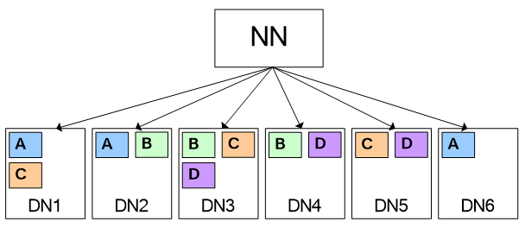
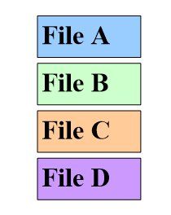
Colocation
The definition of Colocation: is to store associated data or data that is going to be associated on the same storage node.
According to the picture below, assume that file A and file D are going to be associated with each other, which involves massive data migration. Data transmission consumes much bandwidth, which greatly affects the processing speed of massive data and system performance.
Notes:
In the figure, the distributed file system consists of six data nodes, there are four files, each with three replicas.
Assume that file A and file D are going to be associated with each other, which involves massive network switch, costing a lot of Internet、IO resources.

Slide 30
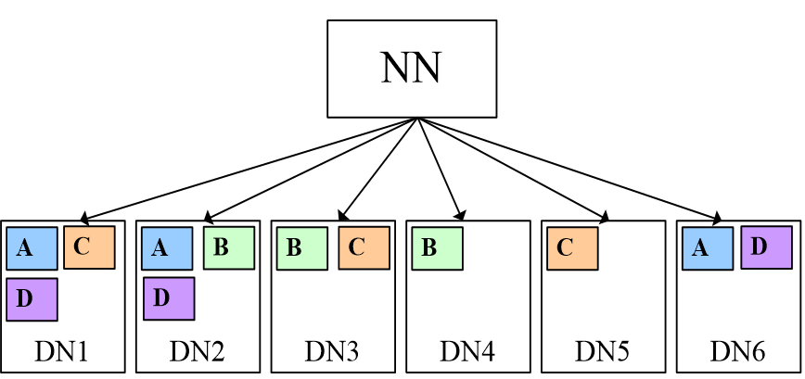
Colocation Benefits
The HDFS colocation: is to store files that need to be associated with each other on the same data node so that data does not have to be obtained from other nodes during associated computing. This greatly reduces network bandwidth consumption.
When joining files A and D with colocation feature, resource consumption can be greatly reduced because the blocks of multiple associated files are distributed on the same storage node.
Notes:
Hadoop implements file-level colocation. That is, the blocks of multiple associated files are distributed on the same storage node. File-level colocation facilitates quick file access, avoiding high costs of data migration.

Slide 31
HDFS Data Integrity Assurance
HDFS ensures the completeness of the stored data. It implements reliability processing in case of failure of each component.
Reconstructs data replicas in invalid data disks.
The DataNode periodically reports blocks’messages to the NameNode, if one replica(block) is failed, the NameNode will start the procedure to recover lost replicas.
Ensures data balance among DataNodes.
The HDFS architecture is configured with the data balance mechanism, which ensures the even distribution of data among all DataNodes.
Ensures metadata reliability.
The log mechanism is used to operate metadata, which is stored on both active and standby NameNodes.
The snapshot mechanism of the file system ensures that data can be recovered in a timely manner when a misoperation occurs.
Provides the security mode.
HDFS provides a unique security mode to prevent fault spreading when a DataNode or hard disk is faulty.
Notes:
Reconstructs the data replica in the invalid data disk:
DataNode sends heartbeat messages to the NameNode periodically to report the data status. The NameNode checks whether the data blocks are completely reported. If the data blocks are not reported because the hardware of the DataNode is damaged, the NameNode initiates the replica reconstruction to recover the lost replica.
Prevents fault spreading with security mode:
When hard disk faulty occurs, the cluster enters security mode. HDFS only supports metadata access. Data in HDFS becomes read-only, and operations such as creating or deleting a file will fail. When the fault is resolved and data recovered, HDFS cluster quit the security mode.

Slide 32
Other Key Design Points of the HDFS Architecture
Unified file system:
HDFS presents itself as one unified file system externally.
Space reclamation:
The recycle bin mechanism is provided and the number of replicas can be dynamically set.
Data organization:
Data is stored by block in the HDFS.
Access mode:
Data can be accessed through Java APIs, HTTP, or shell commands.
Notes:
Disk usage: for example, the disk is 100G, 30G is used, and utilization is 30%.
Load balancing avoids the uneven distribution of data between nodes, resulting in hot node problems.

Slide 33
Common Shell Commands
Type | Commands | Description
dfs | -cat | Show the file contents
 | -ls | Show a directory listing
 | -rm | Delete files
 | -put | Upload directory/files to HDFS
 | -get | Download directory/files from HDFS
 | -mkdir | Create a directory
 | -chmod/-chown | Change the group of files
 | … | …
dfsadmin | -safemode | Safety mode operation
 | -report | Report service status

Slide 34
This module describes the following information about HDFS: basic concepts, application scenarios, technical architecture and its key features.

Slide 35
What is HDFS and what can it be used for?
What are the design objectives of HDFS?
Describe the HDFS read and write processes.
Notes:
Answers：
1. Hadoop distributed file system that runs on commondity hardware. It is applicable to store large files and streaming data access
2. NameNode、DataNode、Client.
3. Read: Client connects to the NameNode to obtain the file information, then connects to the DataNode according to the information obtained from the NameNode to locate the nearest corresponding data blocks. After data reading is complete, the service application invokes the close API to close the connection.
Write: Client connects to the NameNode, and the NameNode create a file node in the metadata. Client connects to DataNodes, and establishes a pipeline of DataNodes. Then Client uses the proprietary protocol to write data to DataNode 1, and copy the data from DataNode 1 to DataNode 2, to DataNode 3. After all data writing is confirmed, the service invokes the HDFS Client to close the file. Client connects to the NameNode to confirm that the data writing is complete.

Slide 36
Training materials:
http://support.huawei.com/learning/Certificate!showCertificate?lang=en&pbiPath=term1000025450&id=Node1000011796
Exam outline:
http://support.huawei.com/learning/Certificate!toExamOutlineDetail?lang=en&nodeId=Node1000011797
Mock exam:
http://support.huawei.com/learning/Certificate!toSimExamDetail?lang=en&nodeId=Node1000011798
Authentication process:
http://support.huawei.com/learning/NavigationAction!createNavi#navi[id]=_40

